Slide 1
Postgres-XL/XC
Scale-out Approach in PostgreSQL
DTCC 2015
Database Technology Conference China 2015
April 18th, 2015
NTT DATA INTELLILINK Corporation
Koichi Suzuki

Slide 2
Introduction

Slide 3
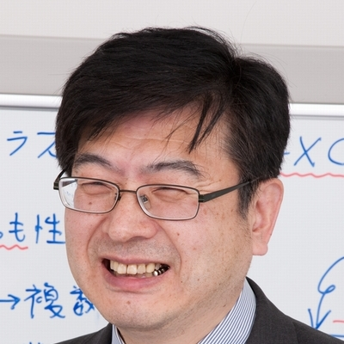
About the Speaker
Fellow at NTT DATA Intellilink Corporation
Principal Technology Professionals at NTT DATA Group
In Charge Of
General Database Technology
Database in huge data warehouse and its design
PostgreSQL and its cluster technology
In The Past
Character Set Standard (Extended Unix Code, Unicode, etc)
Heisei-font development (Technical Committee)
Oracle Porting
Object-Relational Database

Slide 4
Motivation
Growing Database Workload both in OLTP (OnLine Transaction Processing) and OLAP (OnLine Analytical Processing) applications.
Shared-Nothing Approach
  Performance with commodity hardware/software
Extension to existing PostgreSQL
Transparent API
  Internal API could be different
  Transparent libpq Interface
  No significant restriction to transaction ACID properties and SQL language.

Slide 5
Scale-out approach
Distribution/Replication of table rows among different database “nodes”
  Parallelism
  Local join operation
SQL planning for row distribution/replication
Consistent and synchronous transaction management among “nodes”
Performance with commodity hardware/software

Slide 6

Read Scale-out in PostgreSQL Master/Slave
Read/Write Transactions
Possible time delay
Read-only Transactions
Master
Slave
WAL (or Redo Log)

Slide 7

Scaling Out in Postgres XL/XC
Read/Write Transactions
No Delay in Update Visibility
Local Disk
Local Disk
Local Disk
Local Disk
Backend Transaction Synchronization

Slide 8
OLTP Workload Scalability and Table Design

Slide 9

DBT-1 Workload Scalability
DBT-1 (Rev)

Slide 10
Table Design in DBT-1 Benchmark
CUSTOMER
ORDERS
ORDER_LINE
ITEM
SHOPPING_CART
C_ID
C_UNAME
C_PASSWD
C_FNAME
C_LNAME
C_ADDR_ID
C_PHONE
C_EMAIL
C_SINCE
C_LAST_VISIT
C_LOGIN
C_EXPIRATION
C_DISCOUNT
C_BALANCE
C_YTD_PMT
C_BIRTHDATE
C_DATA
O_ID
O_C_ID
O_DATE
O_SUB_TOTAL
O_TAX
O_TOTAL
O_SHIP_TYPE
O_BILL_ADDR_ID
O_SHIP_ADDR_ID
O_STATUS
OL_ID
OL_O_ID
OL_I_ID
OL_QTY
OL_DISCOUNT
OL_COMMENTS
OL_C_ID
I_ID
I_TITLE
I_A_ID
I_PUB_DATE
I_PUBLISHER
I_SUBJECT
I_DESC
I_RELATED1
I_RELATED2
I_RELATED3
I_RELATED4
I_RELATED5
I_THUMBNAIL
I_IMAGE
I_SRP
I_COST
I_AVAIL
I_ISBN
I_PAGE
I_BACKING
I_DIMENASIONS
SC_ID
SC_C_ID
SC_DATE
SC_SUB_TOTAL
SC_TAX
SC_SHIPPING_COST
SC_TOTAL
SC_C_FNAME
SC_C_LNAME
SC_C>DISCOUNT
CC_XACTS
CX_I_ID
CX_TYPE
CX_NUM
CX_NAME
CX_EXPIRY
CX_AUTH_ID
CX_XACT_AMT
CX_XACT_DATE
CX_CO_ID
CX_C_ID
Distributed with Shopping Cart ID
Distributed with Customer ID
SHOPPING_CART_LINE
ADDRESS
SCL_SC_ID
SCL_I_ID
SCL_QTY
SCL_COST
SCL_SRP
SCL_TITLE
SCL_BACKING
SCL_C_ID
STOCK
ADDR_ID
ADDR_STREET1
ADDR_STREET2
ADDR_CITY
ADDR_STATE
ADDR_ZIP
ADDR_CO_ID
ADDR_C_ID
Replicated
ST_I_ID
ST_STOCK
COUNTRY
AUTHOR
CO_ID
CO_NAME
CO_EXCHANGE
CO_CURRENCY
OL_ID
OL_O_ID
OL_I_ID
OL_QTY
OL_DISCOUNT
OL_COMMENTS
OL_C_ID
Distributed with ItemID

Slide 11
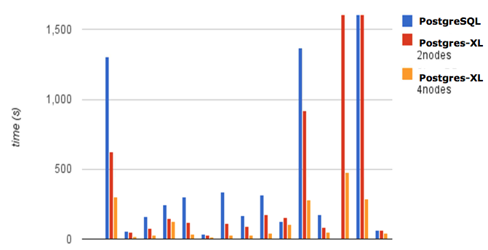
MPP Performance – DBT-3 (TPC-H)
By courtesy of Mason Sharp, Postgres-XL leader

Slide 12
Scale Out Approach (1): Table Distribution/Replication
Categorize tables into two groups:
Large and frequently-updated tables
→ Distribute rows among nodes (Distributed Tables)
→ Based on a column value (distribution key)
→ Hash, modulo or round-robin
→ Parallelism among transactions (OLTP) or in SQL processing (OLAP)
Smaller and stable tables
→ Replicate among nodes (Replicated Tables)
→ Join Pushdown
Avoid joins between Distributed Tables with join keys different from distribution key as possible.

Slide 13
Scale Out Table Design in DBT-1
Three distribution keys:
  Customer ID
  Shopping Cart ID
  Item ID
Some transactions involve joins across distributed tables with non-distribution join keys.

Slide 14
Some More in XL/XC Node Configuration

Slide 15
Node Configuration: Two-Tier Approach
Coordinator:
  Maintains global catalog information
  Build global SQL plan and SQL statements for datanodes
  Interact with datanode to execute local SQL statements and accumulate the result
Datanode
  Maintains actual data (local data)
  Run local SQL statement from Coordinator
  (In XL, datanode may ask other datanodes for their local data)

Slide 16
Coordinator and Datanode
Read/Write Transactions
Coordinator
Datanode

Slide 17
Node Configuration: Yet Another Node: GTM
GTM: Global Transaction Manager
Synchronizes each node's transaction status

Slide 18
Why GTM? Two-Phase Commit Protocol doesn't work?
Two-Phase Commit Protocol Does:
  Maintain database consistency in transactions updating more than one node.
Two-Phase Commit Protocol Doesn't:
  Maintain Atomic Visibility of Updates to other transactions (next slide)

Slide 19
Atomic Visibility and GTM
Node A
Node B
TXN 1
Inconsistent
Read!
Updates A and B
Prepares A and B
TXN 2
Reads B and gets old value
Commits A and B
Reads A and gets new value
GTM monitors TXN activity and make new value available at this timing.

Slide 20
Final Configuration: GTM, Coordinator and Datanode
Read/Write Transactions
Coordinator
GTM
Datanode

Slide 21
Configuration in Practice
Just like configuring many database servers to talk each other
  Many pitfalls
  Pgxc_ctl provides simpler way to configure the whole cluster
    Provide only needed parameters
    Pgxc_ctl will do the rest to issue needed commands and SQL statements.
  Visit
  http://sourceforge.net/p/postgres-xc/xc-wiki/PGOpen2013_Postgres_Open_2013/

Slide 22
Scalability in OLTP Workloads

Slide 23
OLTP Workload Characteristics
Number of Transactions: Many
Number of Involved Table Rows: Small
Locality of Row Allocation: High
Update Frequency: High

Slide 24
Scaling Out OLTP Workload
Read/Write Transactions
Run Transactions in Parallel
Coordinator
GTM
High workload
Datanode

Slide 25
Scalability in OLAP (Analytic) Workloads

Slide 26
OLAP Workload Characteristics
Number of Transactions: Small
Number of Involved Table Rows: Huge
Locality of Row Allocation: Low
Update Frequency: Low

Slide 27
Scaling Out OLAP Workload
SQL
May need less coordinators
Coordinator
Top level aggregation
GTM
Low workload
Datanode
Run Small Local SQLs for each Datanode in Parallel

Slide 28
Join Offloading

Slide 29
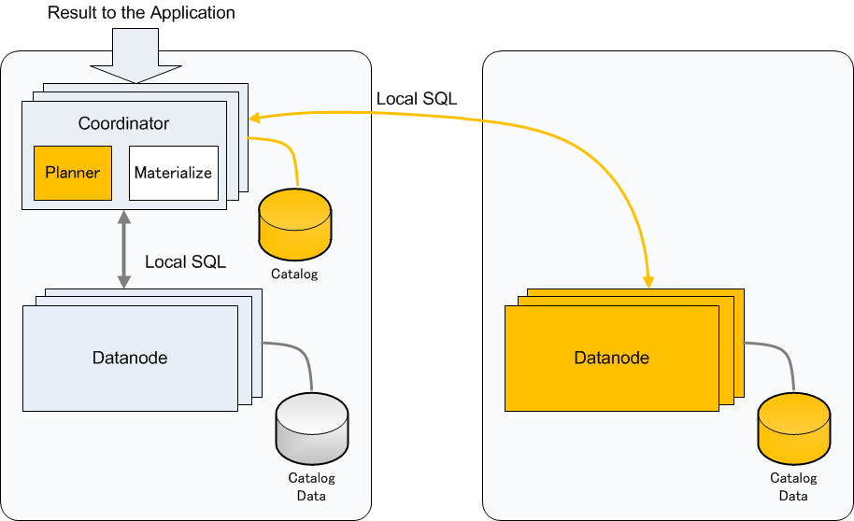
Join Offloading: When row allocation is available
Replicated Table and Partitioned Table
  Can determine which datanode to go from WHERE clause

Slide 30
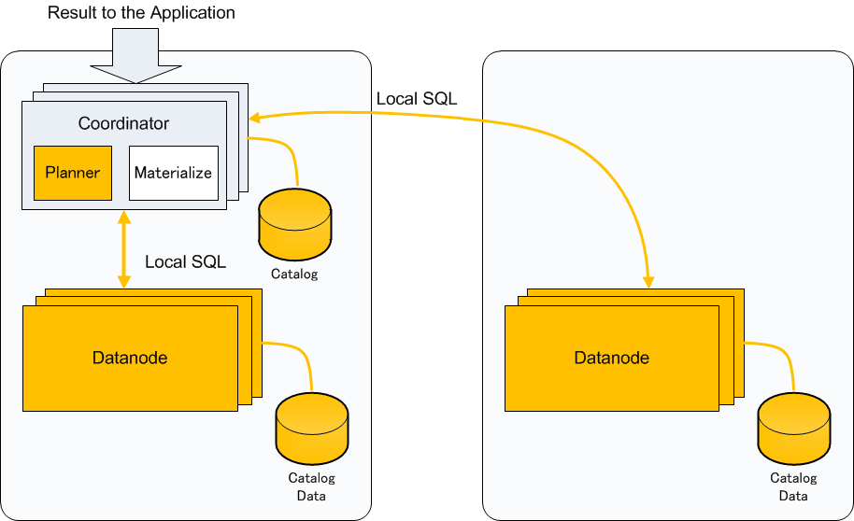
Join Offloading: When row allocation is available
Replicated Table and Partitioned Table
  When the coordinator cannot determine which datanode to go from WHERE clause

Slide 31
Parallel Aggregation

Slide 32
Aggregate Functions in PostgreSQL
Finalize Function
State Transition
Function

Slide 33
Aggregate Functions in Postgres-XC/XL
AVG ← (Sum, Count)
(Sum, Count)
Finalize Function
Collector Function
State Transition
Function
State Transition
Function
State Transition
Function
Coordinator
Datanode
Similar to Map Reduce!

Slide 34
Community status and future

Slide 35
XC and XL community
Postgres-XC is the original community
  Based upon PostgreSQL 9.3
  Tested more for OLPT workload
Postgres-XL was became separate community for more product-oriented and better stability
  Based upon PostgreSQL 9.2
  Shares most of XC code base
  Tested more for OLAP workload
    Direct data capture between datanodes
  Provide many fixes. Most of them apply to XL as well
Unified again?

Slide 36
Product status
Source code inherits all the PostgreSQL repository (at some point)
Fundamental features are all available
  Global transaction management
  SQL statements
  Utilities
Further challenges
  Subtransaction (needed for full function support)
  Catching up PostgreSQL (needed?)

Slide 37
XC and XL community
Both communities need much more resource to move forward
  Developer
  Tester
  Real workload

Slide 38
XC and XL community sites
Postgres-XC
http://sourceforge.net/projects/postgres-xc/
koichi.dbms@gmail.com
Postgres-XL
http://www.postgres-xl.org/

